Slide 1
Files

Slide 2
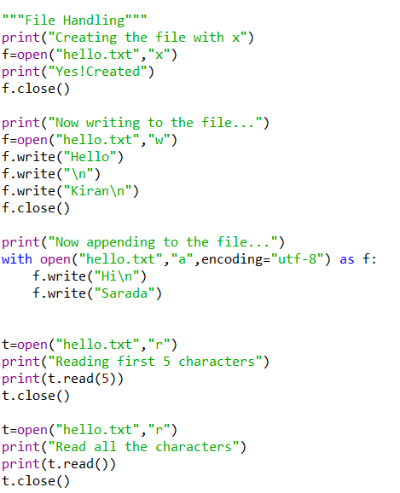
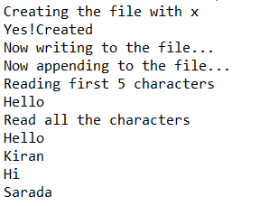
File Operations
Result:

Slide 3
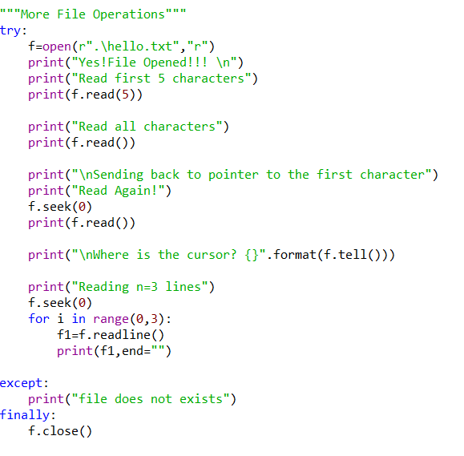
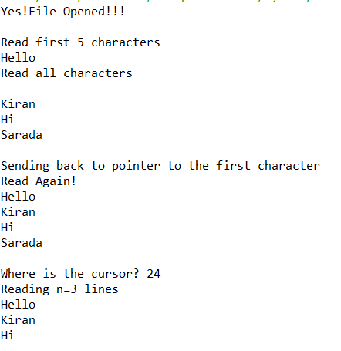
More Operations
Result:

Slide 4
Files Programs
1. Write a Python program to read an entire text file.
2. Write a Python program to read first n lines of a file
3. Write a Python program to append text to a file and display the text.
4. Write a Python program to read last n lines of a file.
5. Write a Python program to read a file line by line and store it into a list.
6. Write a Python program to read a file line by line store it into a variable.
7. Write a Python program to read a file line by line store it into an array.
8. Write a python program to find the longest words.
9. Write a Python program to count the number of lines in a text file.
10. Write a Python program to count the frequency of words in a file.
11. Write a Python program to get the file size of a plain file.
12. Write a Python program to write a list to a file.
13. Write a Python program to copy the contents of a file to another file .
14. Write a Python program to combine each line from first file with the corresponding line in second file.
15. Write a Python program to read a random line from a file
16. Write a Python program to assess if a file is closed or not.
17. Write a Python program to remove newline characters from a file.
18. Write a Python program that takes a text file as input and returns the number of words of a given text file. Note: Some words can be separated by a comma with no space.
19. Write a Python program to extract characters from various text files and puts them into a list.
20. Write a Python program to generate 26 text files named A.txt, B.txt, and so on up to Z.txt.
21. Write a Python program to create a file where all letters of English alphabet are listed by specified number of letters on each line.

